Slide 1

Module 2.2
ER to Relational Mapping

Slide 2
Agenda
ER to Relational Mapping
Mapping rules/guidelines for mapping ER constructs
Mapping rules/guidelines for mapping hierarchies
Examples

Slide 3
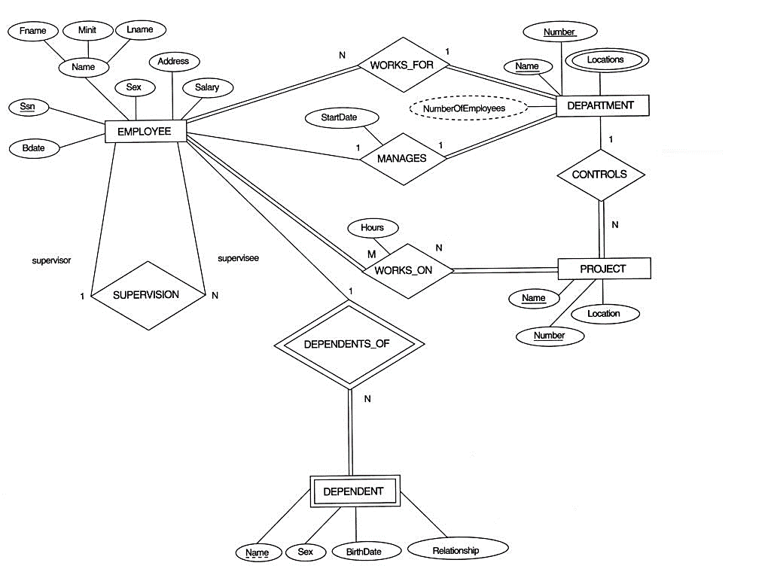
Entity Relationship Model: COMPANY database.

Slide 4
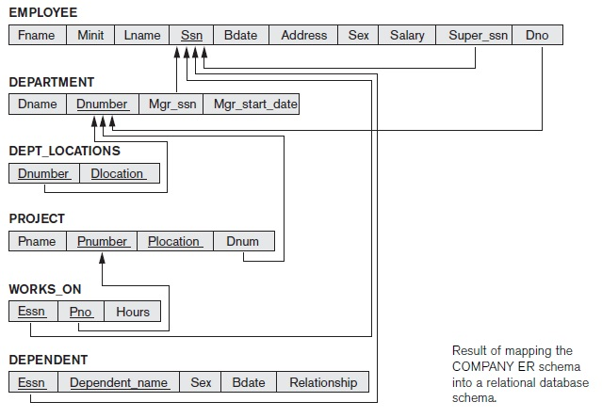
Relational Model: COMPANY database

Slide 5
ER-to-Relational Mapping Algorithm
Step 1: Mapping of Regular Entity Types
For each regular (strong) entity type E in the ER schema, create a relation R that includes all the simple attributes of E.
Include only the simple component attributes of a composite attribute
Choose one of the key attributes of E as the primary key for R
Notes:
Entities :
To interpret the relational database you perceive the real world as a set of objects and relationships between these objects. These basic objects are called entities

Slide 6
ER-to-Relational Mapping Algorithm
Step 1a: Mapping of Regular Entity Types
If the chosen key of E is a composite, then the set of simple attributes that form it will together form the primary key of R
If multiple keys were identified for E during the conceptual design, the information describing the attributes that form each additional key is kept in order to specify secondary (unique) keys of relation R.
Notes:
Entities :
To interpret the relational database you perceive the real world as a set of objects and relationships between these objects. These basic objects are called entities

Slide 7
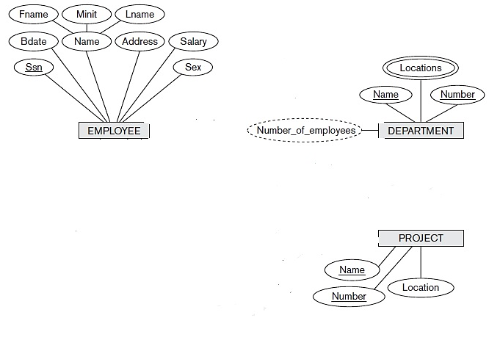
Example
Notes:
Entities :
To interpret the relational database you perceive the real world as a set of objects and relationships between these objects. These basic objects are called entities

Slide 8
ER-to-Relational Mapping Algorithm
Step 2: Mapping of Weak Entity Types
For each weak entity type W in the ER schema with owner entity type E, create a relation R and include all simple attributes (or simple components of composite attributes) of W as attributes of R.
In addition, include primary key of E as foreign key attributes of R (this takes care of mapping the identifying relationship type of W)
The primary key of R is the combination of the primary key(s) of the owner(s) and the partial key of the weak entity type W(if any)
Notes:
Entities :
To interpret the relational database you perceive the real world as a set of objects and relationships between these objects. These basic objects are called entities

Slide 9
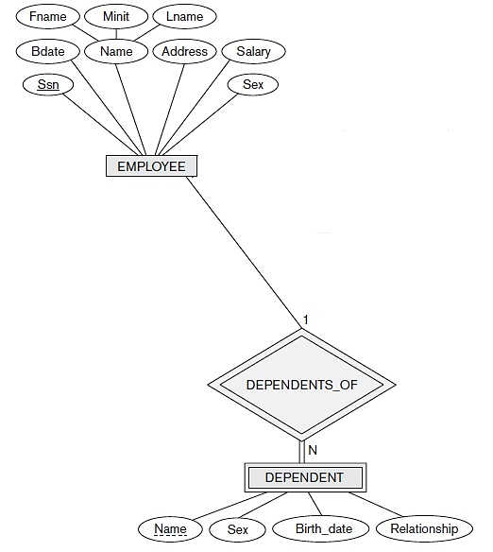

ER-to-Relational Mapping Algorithm
Notes:
Entities :
To interpret the relational database you perceive the real world as a set of objects and relationships between these objects. These basic objects are called entities

Slide 10
ER-to-Relational Mapping Algorithm
Step 2a: Mapping of Weak Entity Types
If there is a weak entity type E2 whose owner is also a weak entity type E1, then E1 should be mapped before E2 to determine its primary key first
It is common to choose the propagate (CASCADE) option for the referential triggered action on the foreign key in the relation corresponding to the weak entity type, since a weak entity has an existence dependency on its owner entity. This can be used for both ON UPDATE and ON DELETE.
Notes:
Entities :
To interpret the relational database you perceive the real world as a set of objects and relationships between these objects. These basic objects are called entities

Slide 11
ER-to-Relational Mapping Algorithm
Step 3: Mapping of Binary 1:1 Relationship Types
For each binary 1:1 relationship type R in the ER schema, identify the relations S and T that correspond to the entity types participating in R.
There are three possible approaches to represent this relationship types:
1) Foreign key approach
2) Merged relationship approach
3) Cross-reference or relationship relation approach
Notes:
Entities :
To interpret the relational database you perceive the real world as a set of objects and relationships between these objects. These basic objects are called entities

Slide 12
ER-to-Relational Mapping Algorithm
Step 3: Mapping of Binary 1:1 Relationship Types
1) Foreign key approach:
Choose one of the relations—S, and include as a foreign key in S the primary key of T
It is better to choose an entity type with total participation in R in the role of S
Include all the simple attributes of the 1:1 relationship type R as attributes of S.
Notes:
Entities :
To interpret the relational database you perceive the real world as a set of objects and relationships between these objects. These basic objects are called entities

Slide 13
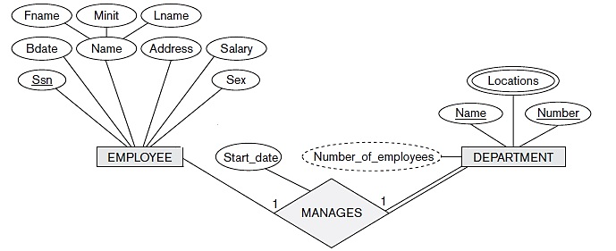

ER-to-Relational Mapping Algorithm
Example
Notes:
Entities :
To interpret the relational database you perceive the real world as a set of objects and relationships between these objects. These basic objects are called entities

Slide 14
ER-to-Relational Mapping Algorithm
Step 3: Mapping of Binary 1:1 Relationship Types
2) Merged relationship approach:
Mapping of a 1:1 relationship type is to merge the two entity types and the relationship into a single relation.
This is possible when both participations are total, as this would indicate that the two tables will have the exact same number of tuples at all times.
Notes:
Entities :
To interpret the relational database you perceive the real world as a set of objects and relationships between these objects. These basic objects are called entities

Slide 15
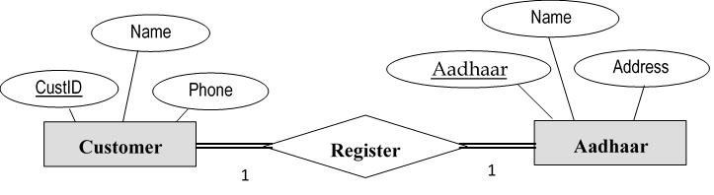
Example
Solution 1:
Customer(CustID, Name, Phone, AadhaarNo)
Aadhaar(AadhaarNo, Name, Address, ……)
Solution 2:
We can merge these two relations.

Slide 16
ER-to-Relational Mapping Algorithm
Step 3: Mapping of Binary 1:1 Relationship Types
3) Cross-reference or relationship relation approach :
set up a third relation R for the purpose of cross-referencing the primary keys of the two relations S and T representing the entity types.
The relation R is called a relationship relation (or sometimes a lookup table), because each tuple in R represents a relationship instance that relates one tuple from S with one tuple from T.
Notes:
Entities :
To interpret the relational database you perceive the real world as a set of objects and relationships between these objects. These basic objects are called entities

Slide 17
ER-to-Relational Mapping Algorithm
Step 3: Mapping of Binary 1:1 Relationship Types
3) Cross-reference or relationship relation approach :
The relation R will include the primary key attributes of S and T as foreign keys.
The primary key of R will be one of the two foreign keys, and the other foreign key will be a unique key of R.
The drawback is having an extra relation, and requiring an extra join operation when combining related tuples from the tables.
Notes:
Entities :
To interpret the relational database you perceive the real world as a set of objects and relationships between these objects. These basic objects are called entities

Slide 18
ER-to-Relational Mapping Algorithm
Step 4: Mapping of Binary 1:N Relationship Types
For each regular binary 1:N relationship type R, identify the relation S that represents the participating entity type at the N-side of the relationship type
Include as foreign key in S the primary key of the relation T that represents the other entity type participating in R
Include any simple attributes of the 1:N relationship type as attributes of S.
Notes:
Entities :
To interpret the relational database you perceive the real world as a set of objects and relationships between these objects. These basic objects are called entities

Slide 19
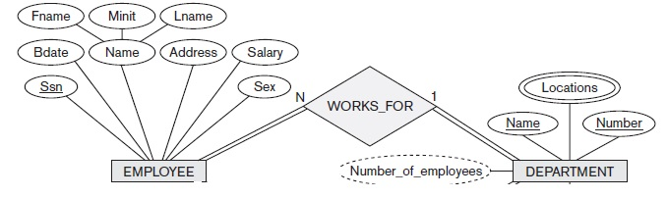
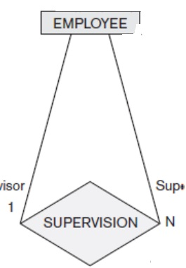
ER-to-Relational Mapping Algorithm
Step 4: Mapping of Binary 1:N Relationship Types
Notes:
Entities :
To interpret the relational database you perceive the real world as a set of objects and relationships between these objects. These basic objects are called entities

Slide 20
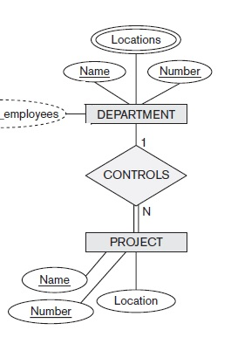
ER-to-Relational Mapping Algorithm
Step 4: Mapping of Binary 1:N Relationship Types
Notes:
Entities :
To interpret the relational database you perceive the real world as a set of objects and relationships between these objects. These basic objects are called entities

Slide 21
ER-to-Relational Mapping Algorithm
Step 5: Mapping of Binary M:N Relationship Types
For each binary M:N relationship type R, create a new relation S to represent R.
Include as foreign key attributes in S the primary keys of the relations that represent the participating entity types
Their combination will form the primary key of S.
Also include any simple attributes of the M:N relationship type as attributes of S.
we must create a separate relationship relation S.
Notes:
Entities :
To interpret the relational database you perceive the real world as a set of objects and relationships between these objects. These basic objects are called entities

Slide 22
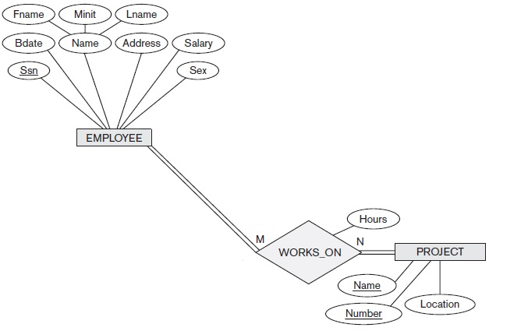

ER-to-Relational Mapping Algorithm
Step 5: Mapping of Binary M:N Relationship Types
Notes:
Entities :
To interpret the relational database you perceive the real world as a set of objects and relationships between these objects. These basic objects are called entities

Slide 23
ER-to-Relational Mapping Algorithm
Step 5: Mapping of Binary M:N Relationship Types
The propagate (CASCADE) option for the referential triggered action should be specified on the foreign keys in the relation corresponding to the relationship R
This is due to each relationship instance has an existence dependency on each of the entities it relates.
This can be used for both ON UPDATE and ON DELETE.
Notes:
Entities :
To interpret the relational database you perceive the real world as a set of objects and relationships between these objects. These basic objects are called entities

Slide 24
ER-to-Relational Mapping Algorithm
Step 5: Mapping of Binary M:N Relationship Types
Notice that we can always map 1:1 or 1:N relationships in a manner similar to M:N relationships by using the cross-reference (relationship relation) approach.
This alternative is particularly useful when few relationship instances exist, in order to avoid NULL values in foreign keys.
In this case, the primary key of the relationship relation will be only one of the foreign keys that reference the participating entity relations.
Notes:
Entities :
To interpret the relational database you perceive the real world as a set of objects and relationships between these objects. These basic objects are called entities

Slide 25
ER-to-Relational Mapping Algorithm
Step 5: Mapping of Binary M:N Relationship Types
For a 1:N relationship, the primary key of the relationship relation will be the foreign key that references the entity relation on the N-side.
For a 1:1 relationship, either foreign key can be used as the primary key of the relationship relation.
Notes:
Entities :
To interpret the relational database you perceive the real world as a set of objects and relationships between these objects. These basic objects are called entities

Slide 26
ER-to-Relational Mapping Algorithm
Step 6: Mapping of Multivalued Attributes
For each multivalued attribute A, create a new relation R.
This relation R will include an attribute corresponding to A, plus the primary key attribute K - as a foreign key in R - of the relation that represents the entity type or relationship type that has A as a multivalued attribute.
The primary key of R is the combination of A and K.
If the multivalued attribute is composite, we include its simple components.
Notes:
Entities :
To interpret the relational database you perceive the real world as a set of objects and relationships between these objects. These basic objects are called entities

Slide 27
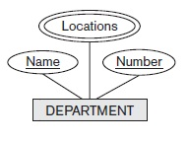
ER-to-Relational Mapping Algorithm
Step 6: Mapping of Multivalued Attributes
DName
DNo | DLocation
1 | Bangalore
2 | Belgaum
3 | Bangalore
2 | Chennai
DNo
DLocations
Department
Notes:
Entities :
To interpret the relational database you perceive the real world as a set of objects and relationships between these objects. These basic objects are called entities

Slide 28
ER-to-Relational Mapping Algorithm
Step 6: Mapping of Multivalued Attributes
The propagate (CASCADE) option for the referential triggered action should be specified on the foreign key in the relation R corresponding to the multivalued attribute for both ON UPDATE and ON DELETE.
We should also note that the key of R when mapping a composite, multivalued attribute requires some analysis of the meaning of the component attributes.
Notes:
Entities :
To interpret the relational database you perceive the real world as a set of objects and relationships between these objects. These basic objects are called entities

Slide 29
ER-to-Relational Mapping Algorithm
Step 6: Mapping of Multivalued Attributes
In some cases, when a multivalued attribute is composite, only some of the component attributes are required to be part of the key of R
These attributes are similar to a partial key of a weak entity type that corresponds to the multivalued attribute
Notes:
Entities :
To interpret the relational database you perceive the real world as a set of objects and relationships between these objects. These basic objects are called entities

Slide 30
ER-to-Relational Mapping Algorithm
Step 7: Mapping of N-ary Relationship Types
For each n-ary relationship type R, where n > 2, create a new relation S to represent R.
Include as foreign key attributes in S the primary keys of the relations that represent the participating entity types.
Also include any simple attributes of the n-ary relationship type as attributes of S.
Notes:
Entities :
To interpret the relational database you perceive the real world as a set of objects and relationships between these objects. These basic objects are called entities

Slide 31
ER-to-Relational Mapping Algorithm
Step 7: Mapping of N-ary Relationship Types
The primary key of S is usually a combination of all the foreign keys that reference the relations representing the participating entity types.
However, if the cardinality constraints on any of the entity types E participating in R is 1, then the primary key of S should not include the foreign key attribute that references the relation E corresponding to E.
Notes:
Entities :
To interpret the relational database you perceive the real world as a set of objects and relationships between these objects. These basic objects are called entities

Slide 32
ER-to-Relational Mapping Algorithm
Step 7: Mapping of N-ary Relationship Types
Notes:
Entities :
To interpret the relational database you perceive the real world as a set of objects and relationships between these objects. These basic objects are called entities

Slide 33
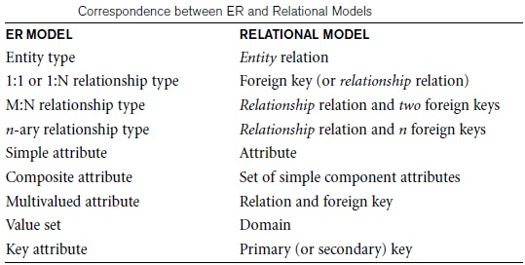
ER-to-Relational Mapping Algorithm: Summary
Notes:
Entities :
To interpret the relational database you perceive the real world as a set of objects and relationships between these objects. These basic objects are called entities

Slide 34
Mapping EER Model Constructs to Relations
Step 8: Mapping of Specialization/Generalization
Attrs(R) to denote the attributes of relation R
PK(R) to denote the primary key of R
Convert each specialization with m subclasses {S1, S2, ..., Sm} and generalized) superclass C, where the attributes of C are {k, a1, ...an} and k is the (primary) key, into relation schemas using one of the following options:
8A: Multiple relations—superclass and subclasses.
8B: Multiple relations—subclass relations only.
8C: Single relation with one type attribute.
8D: Single relation with multiple type attributes.
Notes:
Entities :
To interpret the relational database you perceive the real world as a set of objects and relationships between these objects. These basic objects are called entities

Slide 35
Mapping EER Model Constructs to Relations
Step 8: Mapping of Specialization/Generalization
8A: Multiple relations—superclass and subclasses.
Create a relation L for C with attributes Attrbs(L) = {k, a1, ..., an} and PK(L) = k.
Create a relation Li for each subclass Si, 1≤i≤m , with the attributes Attrbs(Li) = {k} ꓴ {attributes of Si} and PK(Li) = k.
This option works for any specialization (total or partial, disjoint or overlapping).
Notes:
Entities :
To interpret the relational database you perceive the real world as a set of objects and relationships between these objects. These basic objects are called entities

Slide 36
Handling Generalization
Method-2:
SB(AccNo, Balance, Int_Amt)
FD(AccNo, Balance, Dep_Amt)
RD(AccNo, Balance, Rec_Amt)
CA(AccNo, Balance, Od)
Tables to be created are:
(Method-1)
Account(AccNo, Balance)
SB(AccNo, Int_Amt)
FD(AccNo, Dep_Amt)
RD(AccNo, Rec_Amt)
CA(AccNo, Od)
AccNo
Balance
Account
ISA
SB
FD
RD
CA
Int_Amt
Dep_Amt
Rec_Amt
Od

Slide 37
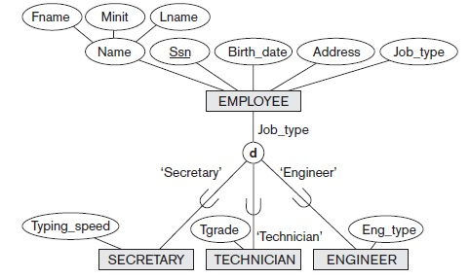
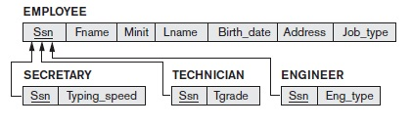
Mapping EER Model Constructs to Relations
Step 8: Mapping of Specialization/Generalization
8A: Multiple relations—superclass and subclasses.
Notes:
Entities :
To interpret the relational database you perceive the real world as a set of objects and relationships between these objects. These basic objects are called entities

Slide 38
Handling Aggregation
USN
StdName
Student
Date
Attend
CourseTiitle
PName
Emp#
CourseId
Credits
Professor
Teach
Course
Professor(Emp#, PName)
Course(CourseId, CourseTitle, Credits)
Student(USN, Stdname)
Attend(USN, CourseId, Emp#, Date)
Teach(CourseId, Emp#)
Aggregation

Slide 39
Summary
Notes:
Entities :
To interpret the relational database you perceive the real world as a set of objects and relationships between these objects. These basic objects are called entities

